Slide 1
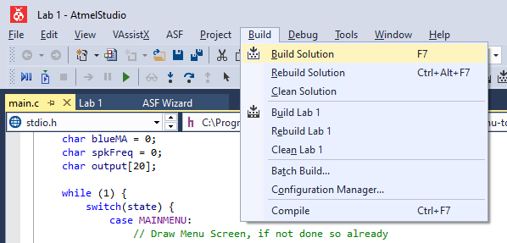
Checking your Code
Use the Build function (F7) in ATMEL studio to check for simple errors:
Syntax Errors
Undeclared Variables / Variables not in scope
Incorrect use of functions

Slide 2
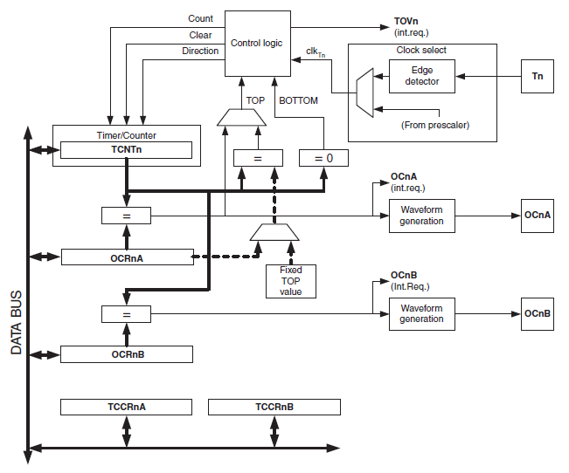
Timers
Clock Select
  Based off f_{osc} (and Prescaler) or from external source (via Tn Pin)
Clock Logic
  This instructs the timer/counter what to do next
  Considers parameters from other inputs (clock pulse, TOP & BOTTOM values, setup registers)
Timer/Counter
  Register TCNTn
  Will either count up, down, or reset to TOP/BOTTOM value
Output Compare Registers
  OCRnA/OCRnB
  Control the outputs on OCnA/OCnB pins on the μC
  OCRnA can also influence the Control Logic
Microchip AT90USB1287 Datasheet

Slide 3
Timer Modes
There are four different modes
  Normal
  Clear Timer on Compare Match
  Fast PWM
  Phase-Correct PWM

Slide 4
Modes - Normal
Timer counts up from 0 to 0xFF (25)
Events can be set on the timer to occur when the values in Output Compare Registers match
Four Compare Match Modes
  Normal
  Toggle
  Clear
  Set
255
TCNTn
Register Value
0
Pulses
Notes:
Normal Operation – The OCnA/B Pin is disconnected and the timer does not influence the output of that pin
Toggle – The OCnA/B Pin toggles it’s output between high and low on a compare match (plotted)
Clear – The OCnA/B Pin sets the output to low on a compare match
Set – The OCnA/B Pin sets the output to high on a compare match

Slide 5
Modes - Clear on Compare Match (CTC)
Timer counts up from 0 to the TOP value stored in OCRnA
When reached, the timer clears to 0, and an Interrupt is triggered (if enabled)
Four Compare Match Modes
  Normal
  Toggle
  Clear
  Set
255
TCNTn
OCRnA
Register Value
0
Pulses

Slide 6
CTC Output Modes
255
TCNTn
OCRnA
Register Value
0
Pulses
Toggle on Compare Match
1
OCnA/B
0
Pulses
Period
Notes:
There are four different modes for CTC Compare Matches:
Normal Operation – The OCnA/B Pin is disconnected and the timer does not influence the output of that pin
Toggle – The OCnA/B Pin toggles it’s output between high and low on a compare match (plotted)
Clear – The OCnA/B Pin sets the output to low on a compare match
Set – The OCnA/B Pin sets the output to high on a compare match
The Clear/Set methods are generally used in conjunction with other code to switch on/off the output pin.
By setting OCRnA, we can adjust the period of the output on OCnA/B. Notice in the toggle mode, we have a 50% Fixed Duty Cycle.

Slide 7
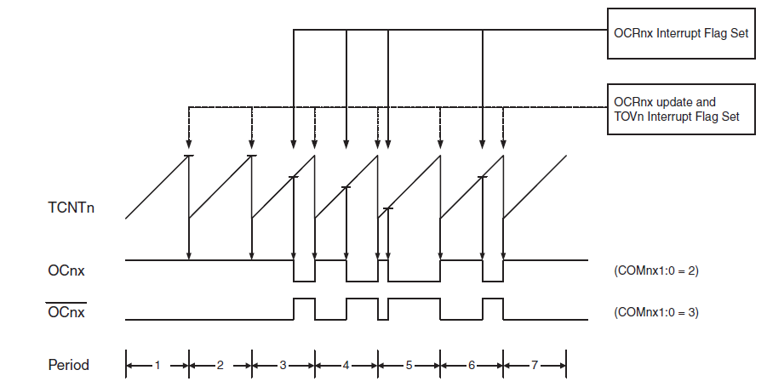
Modes – Fast PWM
Timer counts from 0 to TOP value (0xFF or OCRnA Value)
Outputs on OC2A and OC2B can be set for a non-inverted or inverted output signal.
Microchip AT90USB1287 Datasheet

Slide 8
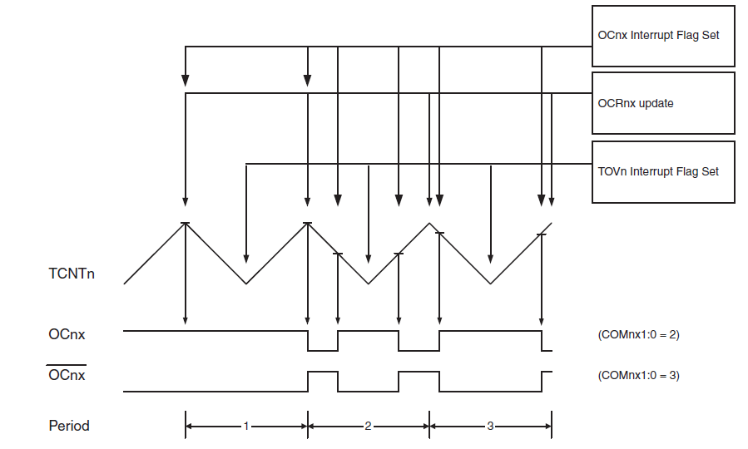
Modes – Phase-correct PWM
Operates similarly to Fast PWM
  Notice how the timer counts UP then back DOWN (two slopes)
  This reduces the effective frequency of PWM (hence not “Fast”)
Microchip AT90USB1287 Datasheet

Slide 9


Calculating Top Values for Frequencies
$$f_{PWM}= \frac{f_{osc}}{2 ×Prescaler ×(Top+1)}$$
$$Top= \frac{f_{osc}}{2 ×Prescaler ×f_{PWM}} −1$$
Notes:
Formulae Useful in Later Weeks – But shows how the prescalers & values were determined in this weeks example code

Slide 10
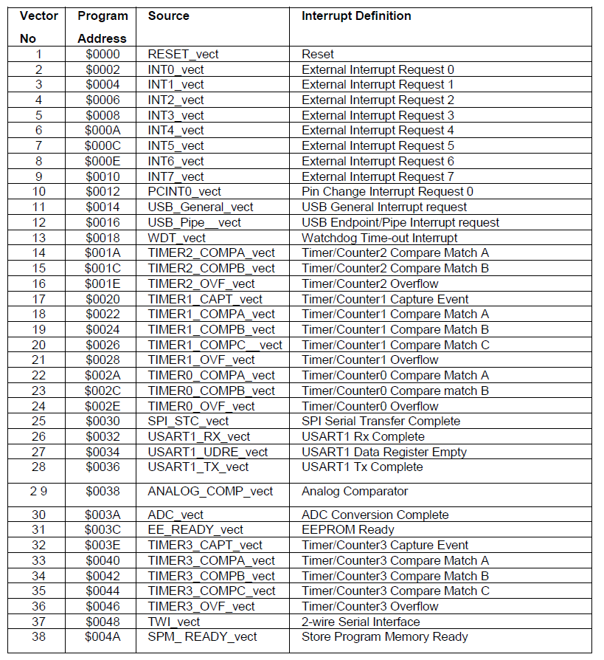
Interrupt Vectors Table
Use this table to identify the vectors you need to use:
Find the subsystem you need (ex. USART)
Find the trigger you want to use (ex. Rx Complete)
Ensure you enable the appropriate interrupt registers for the device (ex. RXCIE Flag in UCSR1B)
Microchip AT90USB1287 Datasheet
Notes:
These slides have been included from last weeks lab for your reference.

Slide 11
Using Interrupts in your Program
Include the <avr/interrupt.h> library
Create Interrupt Service Routines (ISRs) using the function ISR()
  Make sure you also declare the function definition
  Ensure that you pass in the name of the interrupt vector used
  Write the code inside the function that you want to use
Enable Interrupts using the sei() function, and setting the appropriate registers.
// Include the Interrupt Library
#include <avr/interrupt.h>
// Declare the Function Definition
for the ISR
ISR(Your Vector's Name);
// Write the code to run within
your interrupt
ISR(Your Vector's Name)
{
// Your Code Here
}
// Enable Interrupts in your
setup() function
sei();
Notes:
These slides have been included from last weeks lab for your reference.

Slide 12
Example: Receiving Data over USART
This code takes the 8-bit value received over the USART and displays on PORTC:
The example is the basic outline to show you how vectors can be used.
Use the USART1_RX_vect
Enable Interrupts in setup()
  Using the sei() function
Create Interrupt Service Routines (ISRs) using the function ISR()
  Stores the value from the USART
  Writes to PORTC
Ensure interrupts are enabled on the USART registers
  UCSR1B: RXCIE
ISR(USART1_RX_vect);
void setup(void);
int main (void)
{
setup();
}
// Every Time USART recieves data, show on PORTC
ISR(USART1_RX_vect)
{
char valueToDisplay = UDR1;
PORTC = valueToDisplay;
}
void setup(void)
{
DDRC = 0xFF;
UCSR1B = 0b10010000;
UCSR1C = 0b00000110;
UBRR1L = 8;
// Enable Interrupts in your setup() function
sei();
}
Notes:
These slides have been included from last weeks lab for your reference.

